Slide 1


Comparison of Composition Engines and Identification of Shortcomings with Respect to Cloud Computing
Notes:
Hello. I like to welcome you to the presentation of our student report about the “Comparison of Composition Engines and Identification of Shortcomings with Respect to Cloud Computing.
My name is Lukasz Bialy and together with Thomas Bachmann and Anand Babu we will show you the result of our report.

Slide 2
Overview
Problem Statement
Our Approach
Selected Workflow Engines and Workflow Services
Evaluation Criteria
Evaluation Results
Identified Shortcomings
Summary
Notes:
Before we start I would like to give you a short preview about what we will talk about.
- At first I will talk about Problem statement and explain what is the goal of this work.
- As second step I will be speaking about our approach to reach that goal.
From here on Thomas will present us what Wotkflow Enginses and Services were selected.
- Is important to mention, that with workflow services are the SaaS offerings meant that allow to deploy a process in the Cloud.
- After that he will say few words about our Evaluation Criteria.
Anand then will continue with the evaluation results and conclude with the Shortcomings that were identified.
Also he will give us a short summary

Slide 3
Problem Statement

Slide 4

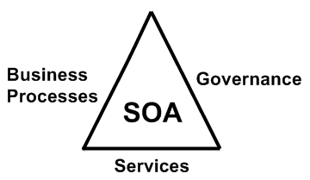
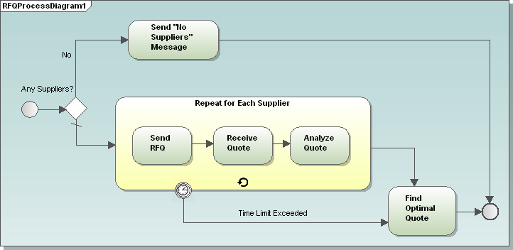
SOA + Workflow + Cloud

Slide 5
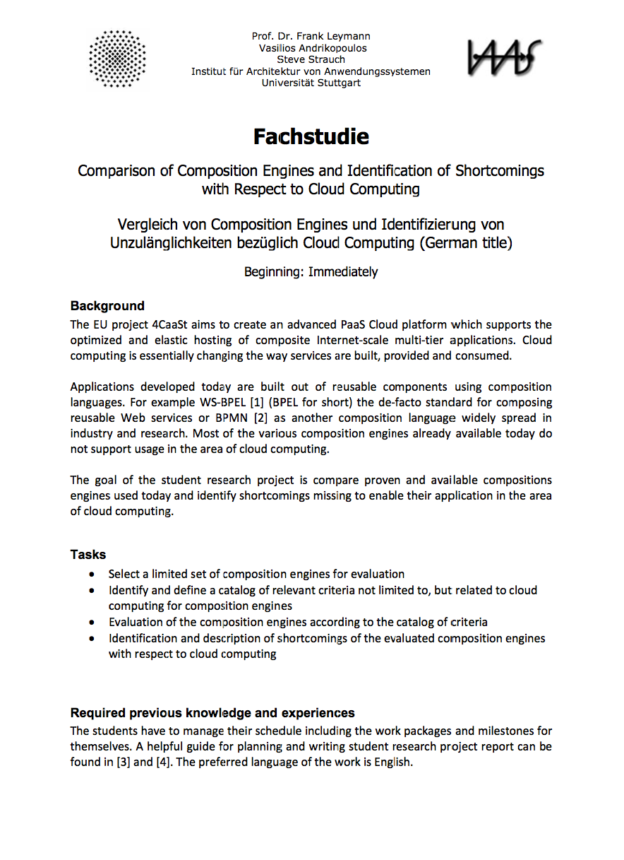
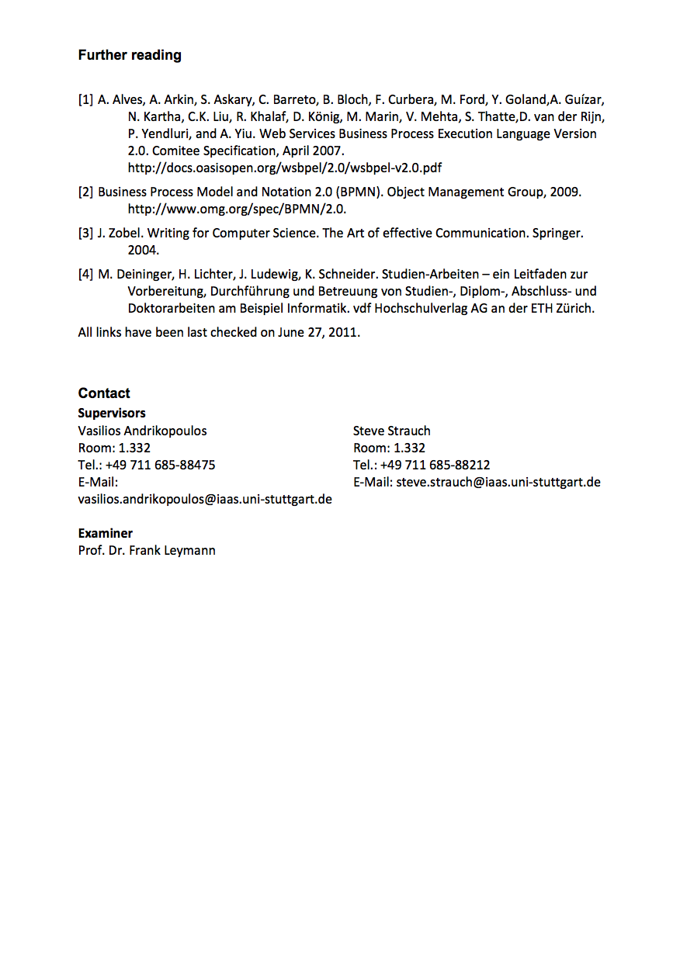
Problem Statement and Scope
Cloud Computing potential
“composition engines” not Cloud aware
EU project 4CaaSt
Task: What‘s the current state of the art?
Evaluate available engines with respect to their Cloud support
Identify shortcomings
Scope: BPEL, BPMN
Notes:
When designing large distributed software systems the Service-Oriented Architecture (SOA) approach is currently the state of the art.
When introducing SOA, proven technologies like Enterprise Service Bus (ESBs) and workflow management systems (WfMSs) are used to enable distributed systems to communicate, using open standards.
Now Cloud computing is an emerging technology with a high potential in terms of cost efficiency and flexibility.
Especially the Platform as a Service (PaaS) delivery model is promising for businesses to rapidly create and run new applications.
The next step is, that services can be delivered through the cloud and workflows can be run in the cloud.
Currently only few platforms are available that use the advantages of the Cloud.
For example allow users to easily create applications by composing Web Services.
For achieving that proven technology, like SOA software components, need to be adapted to the Cloud.
Most software vendor’s SOA components like ESBs or WfMSs are not ready for the Cloud.
For example they don’t support native multi-tenancy or have low scalability.
As a consequence, the EU project 4CaaSt was started.
In this project a PaaS is built, which makes it possible to create new services and applications by composing existing and new services.
Therefore a Cloud-aware workflow engine as building block is needed, to be integrated in the PaaS platform.
This engine is leveraging all Cloud advantages, such as multi-tenancy to maximize the resource utilization for Cloud providers.
This evaluation is embedded in the EU project 4CaaSt (www.4CaaSt.eu).
The task of this student report is to evaluate workflow engines and workflow services in terms of self-defined general workflow engine and Cloud-awareness criteria.
Also it aims to identify common shortcomings, and prioritize them according to importance for achieving Cloud-awareness of workflow engines.
We limited the scope by focusing on BPEL and BPMN engines.

Slide 6
Our Approach

Slide 7
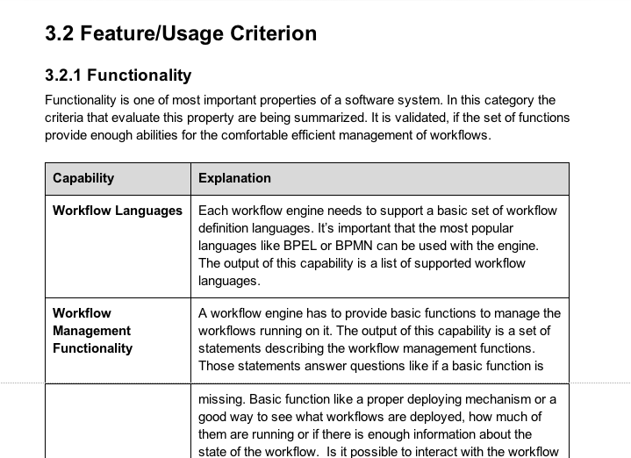
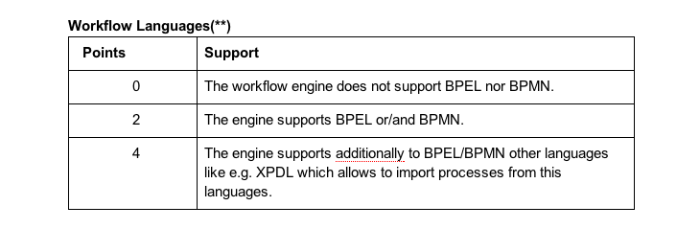
Methodology
Identification of workflow engines and services
Definition of criteria and measureable capabilities
Determine weightings for all capabilities
Define a scale for each capability
Evaluate all selected workflow engines and services
Identify shortcomings and rank them
Notes:
Let’s continue with our approach:
At first we identified the workflow engines and workflow services we wanted to evaluate.
We created a list of potential evaluation candidates based on:
- The “Scientific and Technical Report number D7.1.1” which is also part of the 4CaaSt project.
“Gartner’s Magic Quadrant for BPM Suites” It’s a research of the top 25 vendors in the BPM market.
The official BPMN supporter list
And our advisors input.
We defined criteria and measurable capabilities for workflow engines and services in general and in the Cloud context.
As we can see each capability was well described, to rule out possible inaccuracies and keep the search consisted.
The criteria was created based on 4caat’s report and our experience and knowledge.
For each capability it has been precisely defined what has to be provided, to reach a sudden mark.
Also a weighting for every capability was determinated.
The weighting of a capability depends on it’s importance in a Cloud scenario.
That’s why the capabilities with most significance for the Cloud got a weighting of three.
Capabilities of moderate significance got a weighting of two.
And capabilities with less importance got a weighting of one.
The mark of each capability has been multiplied by it’s weighting.
After we were done with the basics, we evaluated the selected workflow engines and workflow services.
Based on this evaluation we identified the shortcomings and prioritized them.
Now Thomas and Anand will provide you with more details on every one of those steps.
-> if question on weighting comes here, say it will be explained later

Slide 8
Selected Workflow Engines and Services
Notes:
Now I‘d like to briefly introduce a couple workflow engines and services that we selected.

Slide 9
Commercial and Open Source Engines and Services
4CaaSt D7.1.1
WSO2 Stratos / Business Process Server
ActiveVOS Data Center Edition by ActiveEndpoints
Composition Engine by Ericsson
Apache ODE
OW2 Orchestra
BonitaSoft Bonita Open Solution
Commercial Workflow Services
Interstage BPM / Cloud BPM by Fujitsu
Business Operations Platform (BOP) by Cordys
Business Suite by Polymita
BPM by Intalio
RunMyProcess
Commercial Workflow Engines
BPM Suite 11g by Oracle
IBM Business Process Manager
BPMS Enterprise by Intalio
webMethods BPMS by Software AG
Windows Workflow Foundation (.NET) by Microsoft
NetWeaver BPM Process Server by SAP
Open Source Workflow Engines
BPMN Process Engine by JBoss
Activiti
Notes:
out of a list of 67 engines and services with BPEL or BPMN support we chose the following 19 because they were either part of a similar evaluation in the 4CaaSt project, or were big players in the workflow area or seemed to be promising candidates for easy deployment in a Cloud environment
we categorized the 19 engines and services into 4 categories and I’ll briefly introduce two engines from every category a bit more detailed
the first category is the 4CaaSt category which contains the engines that were already evaluated in the 4CaaSt project and needed a deeper evaluation from us
here we want to highlight the open source WSO2 Stratos product which is based on the open source engine Apache ODE with additional multi-tenancy, monitoring and metering support, it is also available as a SaaS solution called WSO2 Stratos Live
another interesting and relatively new candidate is ActiveVOS Data Center Edition by ActiveEndpoints, which supports BPMN 2.0 and BPEL 2.0 and has also multi-tenancy support
we also evaluated Ericsson’s Composition Engine, Apache ODE, OW2 Orchestra and Bonita Open Solution
the second category is the commercial workflow engines one, where we can find the big commercial players in the workflow area
here we want to highlight Oracle’s BPM Suite 11g and IBM’s Business Process Manager which turned out as quite strong workflow engines, although they lack multi-tenancy support, both also support BPMN 2.0 and BPEL and both vendors have also BPM SaaS offerings available
in this category we also considered Intalio’s BPMS Enterprise, Software AG’s webMethods BPMS, Microsoft’s Windows Workflow Foundation and SAP’s NetWeaver BPM Process Server
the third one is the commercial workflow services category, which contains promising workflow services accessible from everywhere over the Internet, which also run in the Cloud already
here we can highlight Fujitsu’s Interstage BPM service, which is available as SaaS as well as on-premise solution, it supports BPMN and BPEL as well as UDDI, has multi-tenancy support and is strong in the process discovery area
another interesting service seem to Cordy’s Business Operations Platform, which is also available as a PaaS product, called BOP, and SaaS product on top of BOP which is called Cordys Process Factory, which seemed not yet enterprise ready
the other three candidates we considered was Polymita’s Business Suite, Intalio’s BPM and RunMyProcess
the last category is the open source workflow engine category, which contains two more open source engines (BPMN Process Engine by Jboss and Activity), which seemed to have a some impact in the workflow landscape, but as it turned out are by far not ready for the Cloud
After we identified the workflow engines and services that we wanted to evaluate, we came up with a list of criteria and capabilities which these engines and service should provide to run them in the Cloud in case of the engines - or - deploy workflows on those service in case of the workflow services

Slide 10
Evaluation Criteria

Slide 11
Functionality, Theory, Integration, Extensibility, Mgmt.
Functionality
Workflow languages & management functionality
Theoretical Foundation
Formal model and verification
Integration and Communication Standards
Protocols, DBs, runtime environments
Extensibility
Plug-in, modularity, APIs, license
Tools and Development
Tools, IDE support, debugging, support
Management and Operation
Web GUI, logging, auditing, engine status
Notes:
the list of criteria with their capabilities came from literature research, the 4caast’s engine evaluation and from white papers of some engine’s
here we have more general criteria that are mainly relevant for traditional workflow engines:
as there are:
the functionality category where we looked at supported workflow languages and management functionalities
the next category was the theoretical foundation category where we looked at the internal formal models of the engines and service and their formal verification means, but we did not find enough information while evaluating the first 7 engines, so we skipped that category further on
the third category was all about integration and communications where we looked at supported protocols, DBS and runtime environments and if the engine can be deployed in the Cloud as a runtime environment
the fourth category is extensibility where we looked at plugin-ins, modularity, APIs and the engine and service’s licenses
the fifth category was about tools and development, here we identified tool and IDE support, debugging functionalities and community or commercial support
the sixth category was management and operation where we looked for Web GUIs and how to do logging, auditing and retrieving engine status information

Slide 12
Scalability, Reliability, Security, Multi-Tenancy, QoS
Scalability & Elasticity
Clustering, Cloud storage, scalability, data transfer
Multi-Tenancy
Customization, isolation, identity and access management, tenant management
Reliability
Transactions, service discovery, exception handling, heavy load, data persistence
Security
Authentication, roles, encryption, compliance
Quality of Service
(Cloud aware) QoS enforcement, metrics, billing
Notes:
and here we have more Cloud-related criteria
as there are:
the category scalability and elasticity, which contains capabilities like clustering support, Cloud storage support, transparent scalability and effective data transfer
the next category was multi-tenancy where we looked at customizations per tenant, data and performance isolation, tenancy based identity and access management and a tenant management portal
the categories reliability and security where we looked at transactions supporting, how are new service discovered in case a service becomes unavailable, central exception handling, same behavior even under heavy load and persistent data
taking the security category we also looked at authentication mechanisms, role support, data encryption and compliance rules support
the last category was QoS, with the Cloud aware QoS enforcement, metrics and billing capabilities. unfortunately we could not find enough information while evaluating the first 7 engines, so we had to skip this category

Slide 13
Evaluation Results
Notes:
Results: 3 min

Slide 14
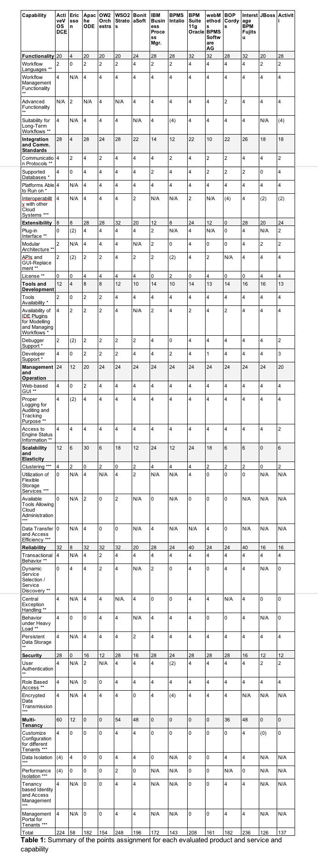
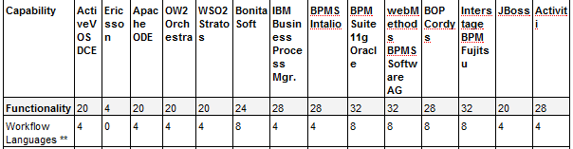
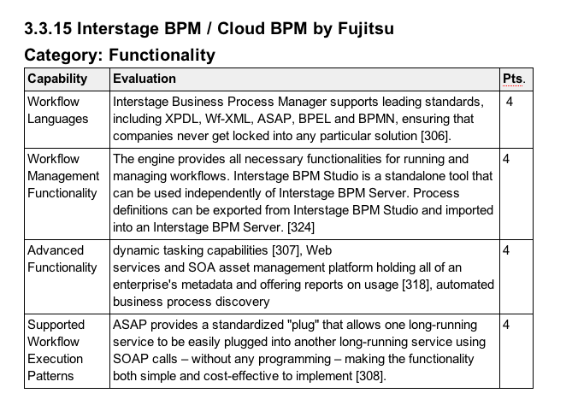
After 19 Evaluations ...
Notes:
TODO (Zoom in one row on the right hand table)
Before i go on to present the final results, we wanted to show a quick glance of how the engine evaluations looked like. For e.g Lets take the workflow languages capability. We said if the engine supported both BPEL and BPMN, we assign 4 points or if it supported either we say 2 points and so on. And then for an engine here interstage, we see that it supports both. The associated resource with which we concluded is documented for defending the markings as shown here. Also, there is a weighing associated with each capability. Over here, its (**) which means the markings are weighed twice.
On the right, you can also see how the entire evaluation of all the engines looked like finally. Oh btw, All cloud related features like mult-tenancy are weighed thrice(***)
Also, I wanted to mention we started with an initial list of 19 engines. On the way 5 of them (Intalio BPM, Windows Workflow Foundation (.Net), Business Suite by Polymita, RunMyProcess and Netweaver BPM Process Server by SAP) could not be further evaluated – Because missing product documentation and availability or not enterprise ready or limited scope of our work,.
So finally we evaluated 14 engines.

Slide 15
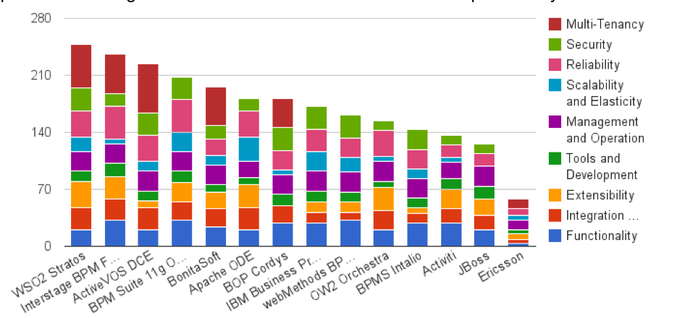
Results of the Evaluation
Notes:
After evaluating the 14 engines,the results looked like that. We found that WS02 to be the most suited workflow engine in a cloud scenario.
Because WSO2 Stratos is the most complete, enterprise-ready, open PaaS with support for more core services as well as building blocks (for example federated identity and single sign-on, data-as-a-service and messaging-as-a-service and more, required for developing SaaS and cloud applications.)
Also the commercial offereings from Fujitsu and ActiveVOS look promising. Its interesting to compare these engines against the traditional big workflow engine providers. For e.g Oracle looks like the best traditional Workflow engine as it seems to score better than the top 3 engines on many of the non-cloud related categories.
However, it is not cloud-aware and doesn’t provide any multi-tenancy and hence falls out of the top 3.
In fact 8 out of 14 don’t have any multi-tenancy support ,though they are major cloud players. Having said that, these 8 engines also have shortcomings that need to be addressed which I will present now.
If you are wondering why we evaluated Ericsson engine which seemed to have not done very well to say the least, it is because they are one of the partners of 4Casst project. All the others are fairly big players in this market providing most of the traditional workflow features atleast.
even after the weightage, the results dint change significantly. (TODO: highlight or overlay traditional vs cloud engines, points on the left side of chart)
start with “although many of the engines support cloud-natively , we identified a few shortcomings.

Slide 16
Identified Shortcomings
Notes:
Time – 6 mins

Slide 17
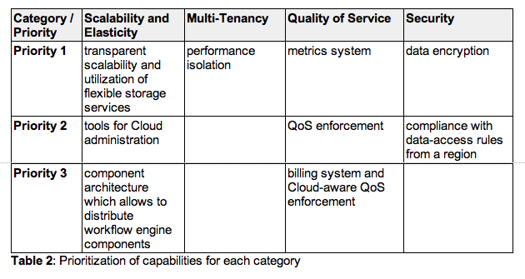
Prioritization of Shortcomings for each Category
Notes:
After evaluating all the engines, we identified the following shortcomings in each category which are also prioritized here(todo: Cut down on explaination of shortcomings further).
when we think of cloud, elasticity goes without saying and hence the engines need to provide transparent scalability. Also, since we are interested in middleware as a service rather than just launching a Virtual Machine with Middleware, the engines need to provide support for flexible storage.
Also, the engine should provide appropriate tools to effectively administer cloud resources with respect to various use cases like green computing etc.
Also, its also necessary that the engine components can be distributed across machines so higher resource utilization can be achieved.
Most of the cloud aware engines provide some sort of multi-tenant support with provisions for data isolation. However many of then engines don’t provide support for performance isolation. It’s a key concern especially if one of the tenants scale transparently and throttle other tenants.
Similarly, the metrics system need to be not only aware of the CPU/memory usage but which tenant is using how much cloud resource. And then the engine needs to provide QOS enforcement capabilities . QoS today involes some manual work. With cloud aware QoS, this can also be automated based on metrics and policies. Its also important that the QoS enforcement is aware of billing systems so that the IT has complete control over its budget just as it has over policies.
6. Also, Security is a top concern in a cloud scenario. Data loss is a reality in Cloud and its mandatory that sensitive data is 100% private even during a backup .Also, there needs to some maturity in compliance( don’t mention this U.S Patriot Act and E.U’s Data Protection Directive)

Slide 18
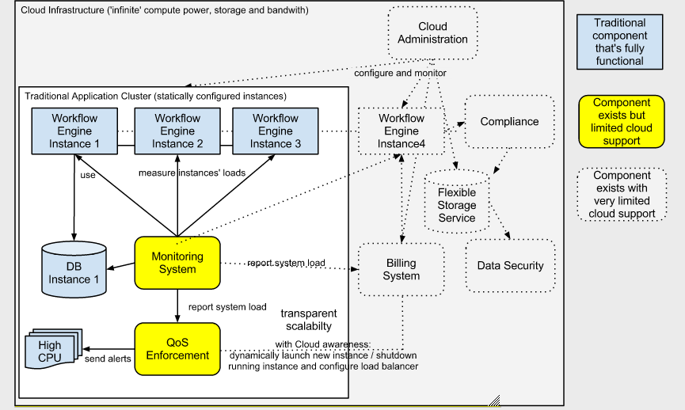
Addressing the Shortcomings
+ performance
Isolation
Notes:
Here, we show a possible cloud scenario where the proposed shortcomings are addressed.
Here, the metric system is upgraded so its aware of multiple tenants and the resource usage of individual tenants
QoS Enforcement fetches the metrics periodically. If there is a need to scale up based on the requested QoS, it queries the Billing System and used the cloud administration tool to launch a new instance. Also, all the instances can access the Flexible Storage Services . Hence we would take advantage of the elastic nature while keeping budget under control.
Also, performance isolation is a key issue that can be ensured at multiple levels, like throttling one of the tenants inside the engine or at Virtual machine level or data usage level.

Slide 19
Summary and Conclusion

Slide 20
Summary and Conclusion
Summary
14- BPEL/BPMN engines evaluated for cloud awareness
Shortcomings identified and prioritized
We are almost there …
Already engines with multi-tenancy support
only few engines support Cloud storage facility or message-as- a-service
Data privacy and compliance – immature
no available engine scales dynamically in the Cloud
no engine supports (Cloud aware) QoS enforcement
no engine supports performance isolation
Outlook
In near future, Enterprises migrate to Private cloud
Notes:
What impact will that have? With Virtualization, automation is achieved at a lower level, in the sense, we can spin-off a VM with an application server pretty fast. However, to fully take advantage of the cloud, we need to have multi-tenancy, because we cant afford to have a VM for each tenant or application.
the workflow engines need to provide native support for flexible storage services and services like database as a service and message-as- a-service. With these capabilities, they can be consumed as services and application developers can concentrate only on the business logic rather than concentrating on how to send messages across different processes or connect to databases which effectively means businesses can respond to market changes faster.
With data encryption a primary concern, the application designer or the enterprise architect need to be aware of compliance requirements as well as cloud storage so that the cloud resources can be consumed as a service over the cloud.
As well as 5 - These are areas that still needs maturity among the available workflow engines.
So as you can see, some features are already provided or on the way and there are some areas which are open with plenty of challenges.
In the near future, we see lot of enterprises migrating to private cloud and hence the workflow engines need to be adapted to fit the scenario right away. Once the security and compliance issues mature, there will be further momentum in hybrid and public cloud as well. So its an exciting time for all of us.

Slide 21
End Of Document

Slide 22
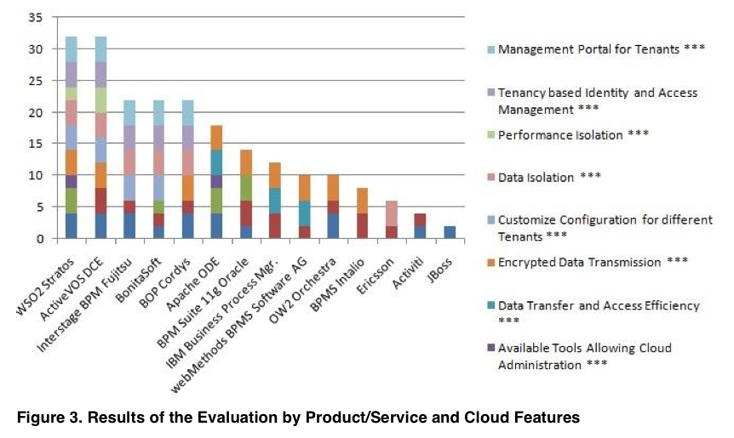

Slide 23
TODO: excel sheet
https://docs.google.com/a/thobach.de/spreadsheet/ccc?key=0AtZbUcaI-mzmdGlPWGxEcG1LYzBwVGJQQkdTOTV6V3c#gid=0

